Slide 1

INTERNET OF THINGS
Smart objects
Charanraj B R
Department of Computer Science Engineering

Slide 2

Internet of things
Smart objects
Charanraj B R
Department of Computer Science Engineering

Slide 3
Designing of IoT Solution
Outline of Presentation
Sensors

Slide 4

INTERNET OF THINGS
Sensors
A sensor is a system whose purpose is to detect events or changes in its environment and send the information to a computer processor.
It senses
Digital representation
Useful data
Human sense
Not limited
Embedded in any physical objects

Slide 5
INTERNET OF THINGS
Different categories of Sensors
Active or passive
Invasive or non-invasive
Contact or no-contact
Absolute or relative
Area of application

Slide 6
INTERNET OF THINGS
Sensors
How sensors Measure?
What sensors Measure?

Slide 7
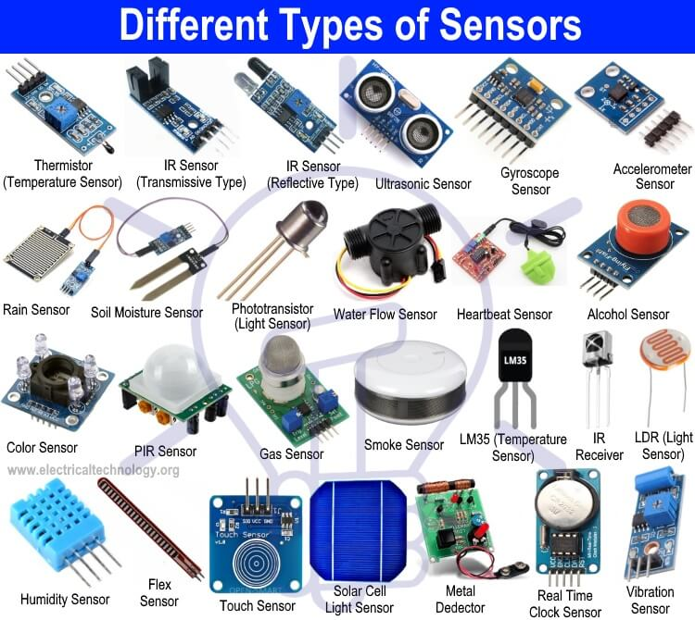
INTERNET OF THINGS
Types of Sensors

Slide 8
INTERNET OF THINGS
Types of Sensors
Sensor Types | Description | Examples
Position | A position sensor measures the position of an object, the position measurement can be either in absolute terms (absolute position sensor) or in relative terms (displacement sensor). Position sensors can be linear, angular or multi-axis. | Potentiometer, inclinometer, Proximity sensor
Occupancy and motion | Occupancy sensor detect the presence of people and animals in a surveillance area, while motion sensors detect movement of people and objects. The difference between the two is that occupancy sensor generate a signal even when a person is stationary, whereas motion sensors do not. | Electric eye, radar

Slide 9
INTERNET OF THINGS
Different categories of Sensors
Sensor Types | Description | Examples
Velocity and acceleration | Velocity (speed of motion) sensors may be linear or angular, indicating how fast an object moves along a straight line or how fast it rotates. Acceleration sensors measure changes in velocity. | Accelerometer, gyroscope
Force | Force sensors detect whether a physical force is applied and whether the magnitude of force is beyond a threshold | Force gauge, viscometer, tactile sensor (touch sensor)

Slide 10
INTERNET OF THINGS
Different categories of Sensors
Sensor Types | Description | Examples
Pressure | Pressure sensors are related to force sensors, measuring force applied by liquids or gases. Pressure is measured in terms of force per unit area | Barometer, Bourdon gauge, piezometer
Flow | Flow sensors detect the rate of fluid flow. They measure the volume (mass flow) or rate (flow velocity) of fluid that has passed through a system in a given period of time. | Anemometer, mass flow sensor, water meter
Light | Light sensors detect the presence of light (visible or invisible) | Infrared sensor, photodetector, flame detector

Slide 11
INTERNET OF THINGS
Different categories of Sensors
Sensor Types | Description | Examples
Acoustic | Acoustic sensors measure sound levels and convert that information into digital or analog data signals. | Microphone, geophone, hydrophone
Humidity | Humidity sensors detect humidity (amount of water vapour) in the air or a mass. Humidity levels can be measured in various ways: absolute humidity, relative humidity, mass ratio and so on. | Hygrometer, humistor, soil moisture sensor

Slide 12
INTERNET OF THINGS
Different categories of Sensors
Sensor Types | Description | Examples
Radiation | Radiation sensors detect radiation in the environment. Radiation can be sensed by scintillating or ionization detection. | Geiger-Muller counter, scintillator, neutron detector
Biosensors | Biosensors detect various biological elements such as organisms, tissues, cells, enzymes, antibodies and nucleic acid. | Blood glucose, biosensor, pulse oximetry, electrocardiograph

Slide 13
INTERNET OF THINGS
Different categories of Sensors
Sensor Types | Description | Examples
Temperature | Temperature sensors measure the amount of heat or cold that is present in a system. They can be broadly of two types: contact and no-contact. Contact temperature sensors need to be in physical contact with the object being sensed. Non-contact sensors do not need physical contact, as they measure temperature through convection and radiation | Thermometer, calorimeter, temperature gauge

Slide 14
INTERNET OF THINGS
Different categories of Sensors
Sensor Types | Description | Examples
Chemical | Chemicals sensors measure the concentration of chemicals in a system. When subjected to a mix of chemicals, chemicals sensors are typically selective for a target type of chemical (for example a CO2 sensor senses only carbon dioxide). | Breathalyzer, Olfactometer, smoke detector

Slide 15
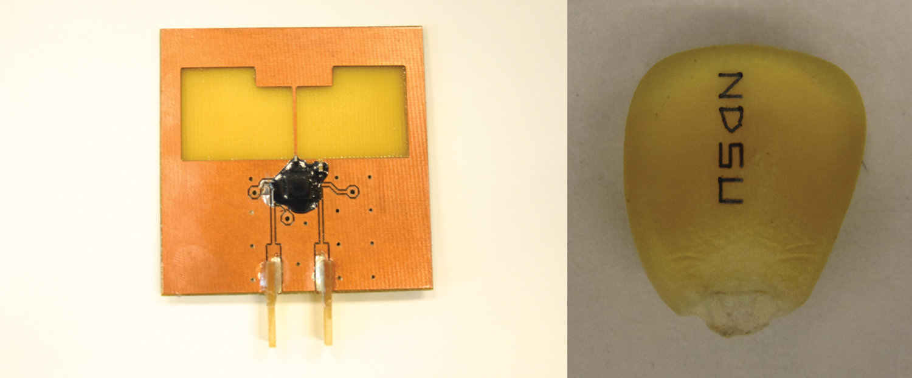
INTERNET OF THINGS
Biodegradable Passive micro Sensors

Slide 16
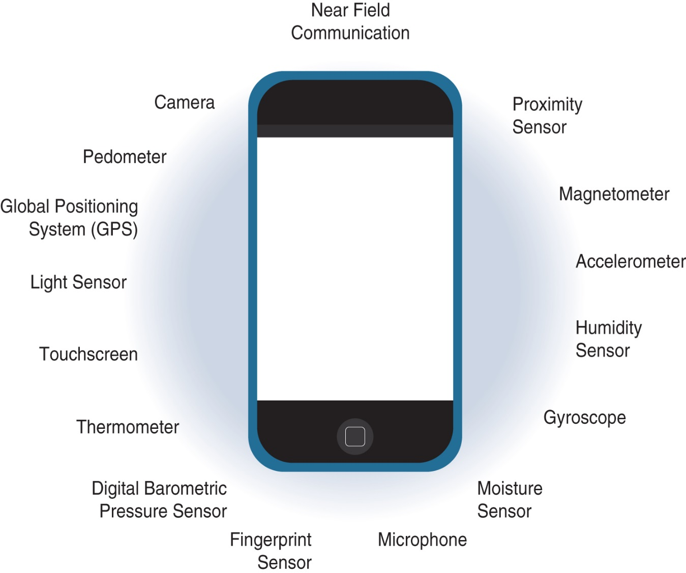
INTERNET OF THINGS
Sensors in a Smart Phone

Slide 17
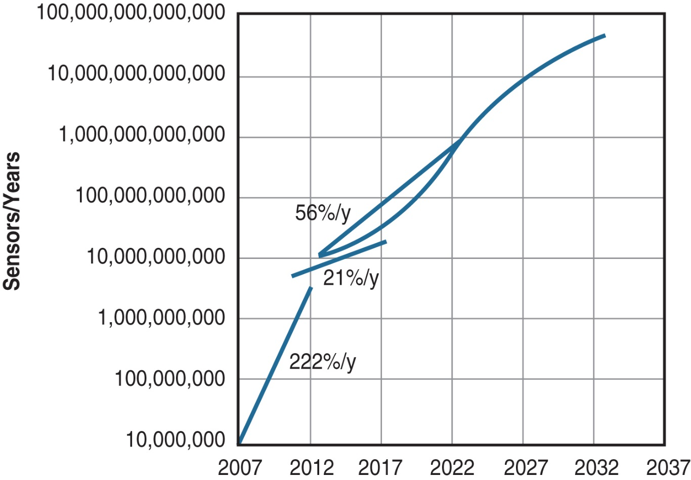
INTERNET OF THINGS
Growth and Predictions in the Number of Sensors

Slide 18
THANK YOU
Charanraj B R
Department of Computer Science Engineering
charanrajbr@pes.edu
+91 80 6666 3333 Extn 721

